Slide 1
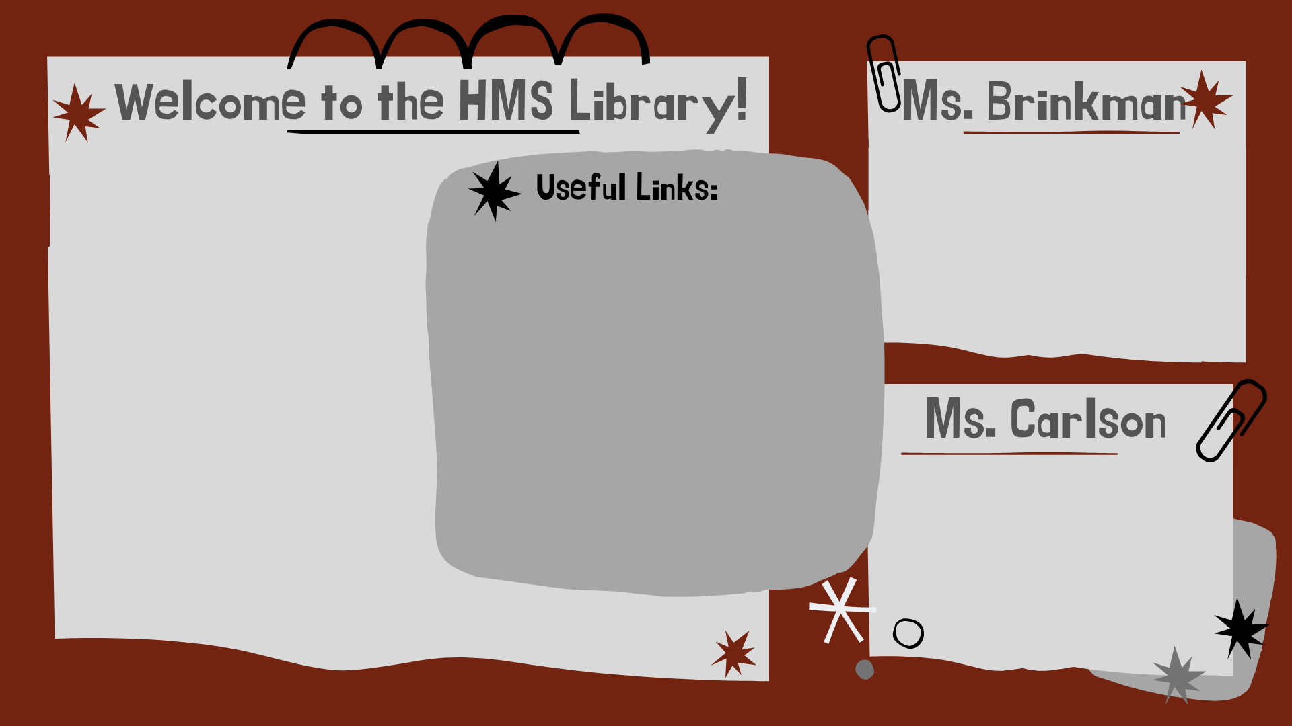
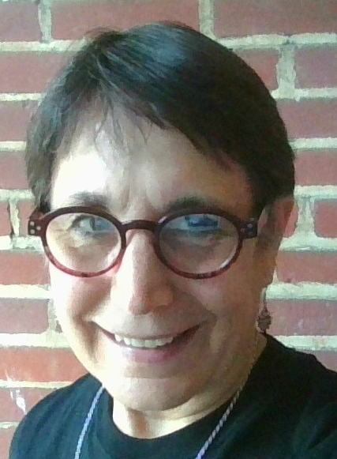
While this year is very different the norm, we are still committed to helping our students develop a love of reading, find great books, and access reliable information for research.
1. HMS Library Google
Classrooms
7th Grade (code: fvllyuq)
8th Grade (code: saff2th)
Kathy Brinkman: kmbrinkman1@fcps.edu
2. HMS Library Website
You can also reach this link
from the HMS homepage:
https://herndonms.fcps.edu
3. The HMS Library pages on
Blackboard.
Cindy Carlson: cbcarlson1@fcps.edu

Slide 2
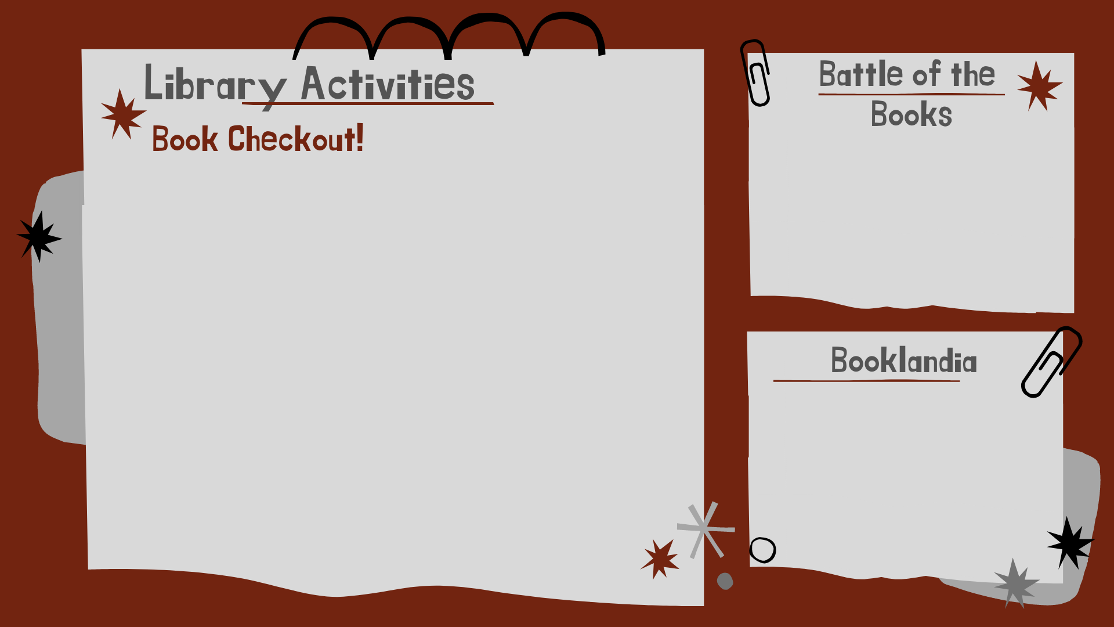
Join a team, read great books, & compete in a spring trivia contest with teams from 5 other FCPS middle schools!
You can still borrow books! How...?
1. Put the book you want on hold. Click here to learn how.
2. When your book is available, a
librarian will email you to schedule a
book pick up.
Join the librarians and your friends, talk about what you’re reading, get book suggestions, & hear about new books.
3. Come to our Contactless Curbside Pickup to get your book! Pickup is each Monday, 11:00 AM to 2:00 PM, or by appointment.

Slide 3
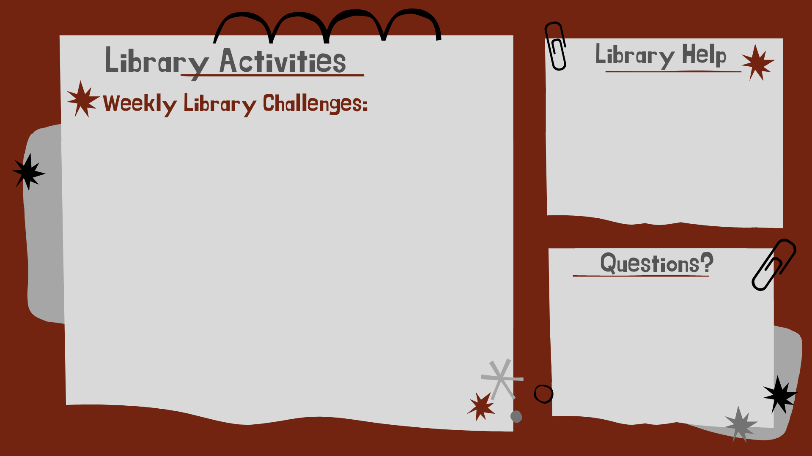
Meet the librarians in our Google Classrooms for research help, book suggestions, or just to chat.
Tu-Fr at lunch &
on even days during Hawks Nest, 9:45-10:20.
Students can also work on our independent, asynchronous, challenges: The Great Library Online Scavenger Hunt (GLOSH), to learn library skills and collect achievement badges, and the Library Picture Challenges, to use critical thinking and detective skills to answer questions and earn Jolly Ranchers.
Email us anytime. We usually respond to within 24 hours, often within a few minutes.
Kathy Brinkman: kmbrinkman1@fcps.edu
Cindy Carlson: cbcarlson1@fcps.edu

