Slide 1
Using Our New Library Catalog: Destiny

Slide 2
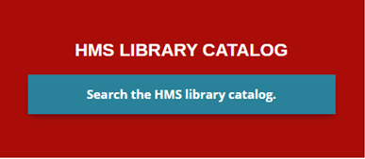
How to Get There
Follow these easy steps:
Go to the Herndon MS Website.
Select Library at the top menu.
Click here:
This will bring you to Destiny Discover, our searchable catalog.

Slide 3
Destiny Discover & Destiny

Slide 4
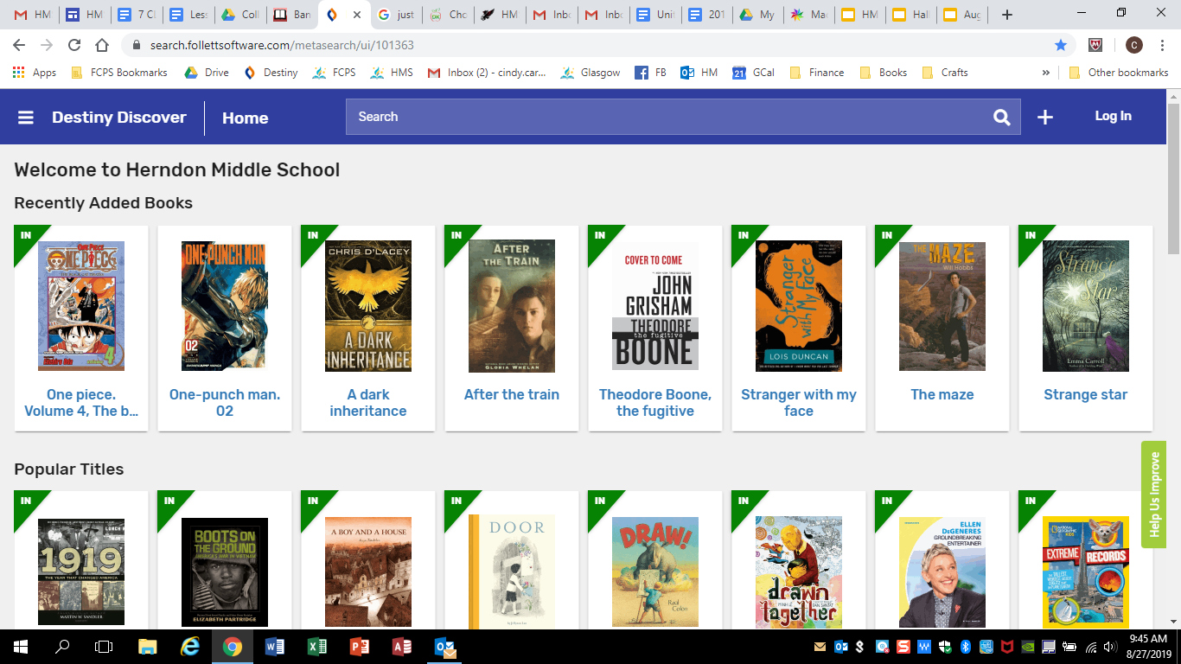
Using Destiny Discover
For searching by genre or with simple keyword searches.

Slide 5
Using Destiny
Best for most searches. Similar to the old catalog, but better!
From Main Menu, Select Destiny.

Slide 6
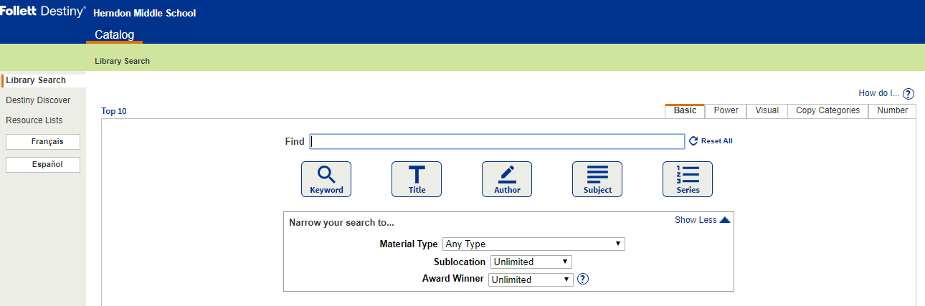
Destiny – Basic Search

